Slide 1


UG Student with disabilities feedback on online learning in COVID-19
April 2020

Slide 2
Student Feedback on online learning – April 2020
Email sent in March 2020 to Students with Disabilities:
Online Learning Feedback
Trinity is embarking on online teaching online during the COVID19 period. SU Disability Officer and the Disability Service are keen to get feedback on what works well and what needs improving. Please let us know your thoughts here:
https://docs.google.com/forms/d/e/1FAIpQLSdUte0eUM30P7cYM4t5bJyYdmbf0T-tzFSJk95Sbrv1y55edA/viewform

Slide 3
Questions asked:
Year and Course Title
Have you had positive experiences with the new online learning platform?
Do you feel it is inaccessible/accessible? please explain
Have all of your online lectures been consistent in their delivery of online materials? What works/ does not work?
What could be improved? Please be as detailed as possible
Comments

Slide 4
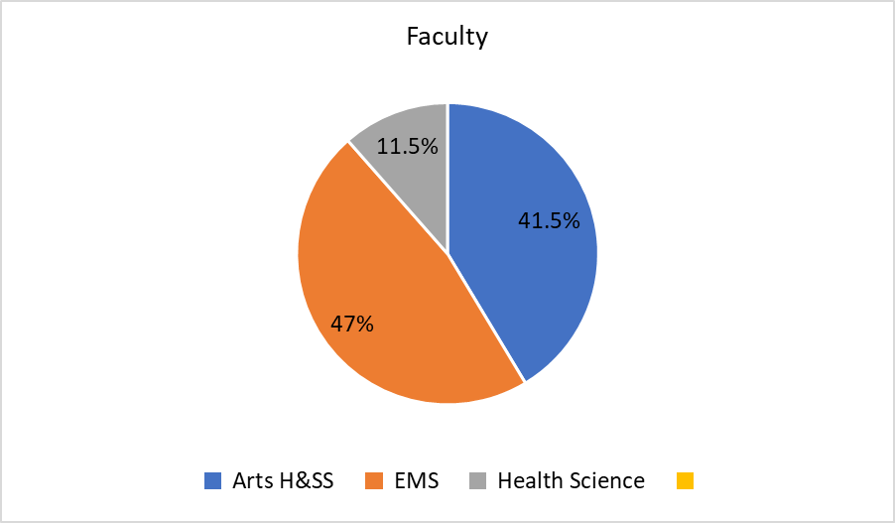
1. Responses by Faculty:

Slide 5
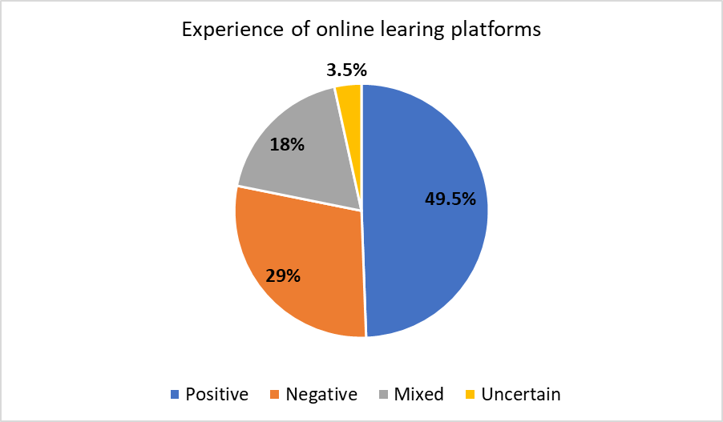
2. Have you had positive experiences with the new online learning platform?
The responses from students were provided in free text and were largely qualitative. 49.5% of students indicated that their experience of online learning was positive, 29% said it was negative, 18% had a mixed experience, and 3.5% were uncertain in their replies.

Slide 6
Sample of responses:
Positive:
Yes absolutely, it's like a podcast. I'd honestly use it pandemic or not.
Yes some lecturers were very quick to put online versions of the lectures on Panopto
Negative:
Not really - only 10 out of (approx) 45 lectures that were left to cover across all of my modules have had lecture recordings uploaded online. I understand this is a stressful situation for everyone but not knowing if/when content will be uploaded is really distressing in final year.
I do not feel like teachers know how to use it. There are capabilities which would allow for group discussions and such online, yet not one teacher has used them. I am getting emails asking me to email answers to questions for tutorials, instead of having those questions be answered as group discussions, as would happen in a tutorial.
Mixed:
Mixed, I have found the lectures that have been uploaded very useful but there has been poor communication around it

Slide 7
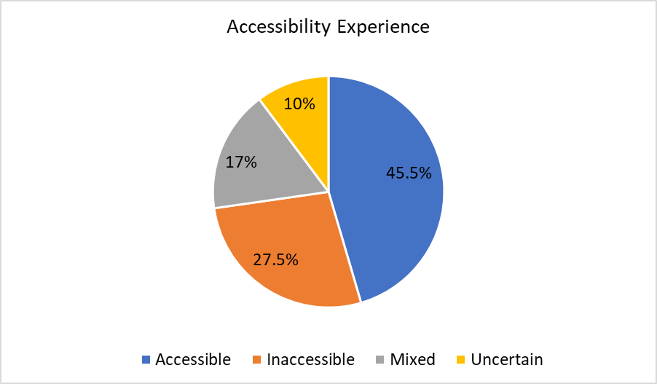
3. Do you feel it is inaccessible/accessible? please explain

Slide 8
Sample of responses:
Accessible:
It's very accessible for me because I can pay attention more than I'd normally be able to and I can be comfortable
It is accessible but more confusing and harder to keep track of the emails
Some lecturers chose to do it on power point, so some of the audio on the slides was cut, which was a bit annoying to follow the lecture
Not accessible:
I don't find the Panopto method good as there is no opportunity to ask questions or clarify something
Mixed:
Yes and no. The blackboard online lectures are great but not all lecturers are using blackboard making it difficult to keep track of where everything is supposed to be.
The lecture recordings themselves (the few that have been uploaded) are actually really well done and easy to follow - it's the finding them and lack of organisation into folders/ delay in uploading that I'm having an issue with

Slide 9
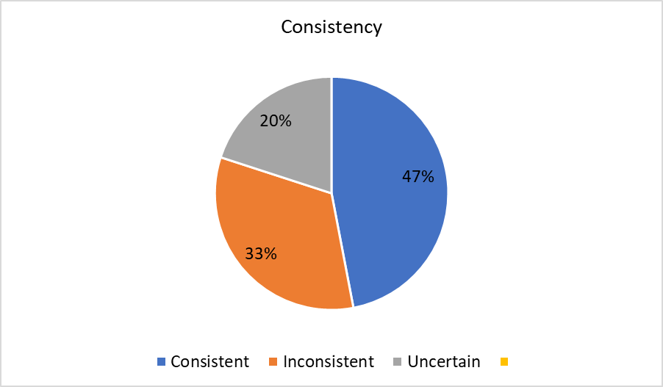
4. Have all of your online lectures been consistent in their delivery of online materials? What works/ does not work?

Slide 10
Sample of responses:
Yes:
The majority of lecturers have been consistent. Videos are more useful than uploading just lecture notes.
I believe recorded lectures are superior to live lectures as there are sometimes during the day when my internet is required from people like my dad or sister who are working from. Therefore I can't make it to the live lectures.
No:
There are two lecturers that we don’t know what to do other than read over old tutorials rather than new materials. I believe that the live lectures are the best and most effective method of learning as it creates a routine and allows more active learning with polls and questions.
No. Some lecturers are consistent, but others send very little information and that is stressful.
Uncertain:
They have just started so I can’t comment on this at this point
I don't know as I'm having trouble even loading the blackboard page.

Slide 11
5. What could be improved? Please be as detailed as possible
The recommendations from students were provided in free text and were largely qualitative. 24 out of 81 responses related to improving accessibility, 10 students asked for a more co-ordinated approach and 9 students asked for information about assessments. The remainder of the recommendations are summarised in the table below:

Slide 12
Sample of responses:
Improve accessibility:
More access to recorded videos so people who work at a slower pace can catch up
One platform with one method to for live lectures as some are using different
Subtitles and/or transcripts for videos and audio file lectures that are not streamed live.
Coordinated approach:
The lecturers could ensure that they have the work necessary for the lecture that day uploaded before the lecture takes place. It's not fair on students to have to change their work schedule to catch up on work the lecturer has been late in uploading.
If all lecturers used the same platform using the same links. I have to go through a different link for one of my modules than the others. Not having the library facility makes it more challenging and to find online books can take time. Having links to this would be helpful.

Slide 13
Assessment information needed:
I don't think there's much that could be improved aside from maybe more clarification on weightings for assignments changing
A clear outline of what is expected of us would be greatly appreciated but even more so would be an understanding that it is extremely difficult to focus, study and prepare for exams when the format, date and even topics to be examined are still so unclear.
Live interactive lectures/tutorials:
Live lectures being recorded. PDFs being uploaded as word documents as well since they're easier to load. And for the lecturers to agree to update us on one place, either black board or email, for everything that is required of us.
For any of the lectures that don't require presenting slides and just feature a lecturer talking, it would be better if we could see the lecturer
Clear Information:
A clear outline of what is expected of us would be greatly appreciated but even more so would be an understanding that it is extremely difficult to focus, study and prepare for exams when the format, date and even topics to be examined are still so unclear.

Slide 14
6. Additional Comments
My main concern at this period is the lack of information regarding what will replace the exams. I am struggling with energy and it is making me anxious. With rumours that written assignments might be made longer or that exams will be online, it is hard not feel overwhelmed. If exams are online, I am worried about typing as I worry the difference of typing and writing by hand as the former will take longer and use more headspace. As I already have a lot of work to do and I am worried about getting it all done without more work on top of it.
I think the college have to be more realistic in their expectations, we still have many deadlines and online testing due, as if nothing has changed. There are people like myself, who is in the most vulnerable category for Covid 19 who also have many worries at this time, the safety of elderly parents and those with young children. In my opinion they should scrap testing and just revaluate the marks for the projects we are still working on. I think reducing the amount of work we still have to do would be in the best Interests of everyone in these difficult times.
I think it would be incredible if lecture recordings could be uploaded online in the future, even when in person classes are taking place. I cannot stress enough how incredible it has been to be able to pause a lecture to process the information and take my time to make detailed notes.

Slide 15
Thank You!
Questions?

